Slide 1
Python by smell
Advanced Python constructs for scientists
Pietro Berkes, Nagra Insight

Slide 2
What’s this smell?
You’re here because you started feeling the “code smell”
Scientists in the wild tend to write this…
What is the smell of the code in the notebooks?
Notes:
“code smell” is an actual technical term!
~/n/employees/MatthieuHarbich/generative/ Open Generative%20model%20-%20Mixture%20of%20gaussians_EM_markovModels_soft_clustering-plotLH-C%2BCLEAN-LH_TEST-4k-Copy1.ipynb
Then open any other with similar name
It smells like you need a Python module

Slide 3
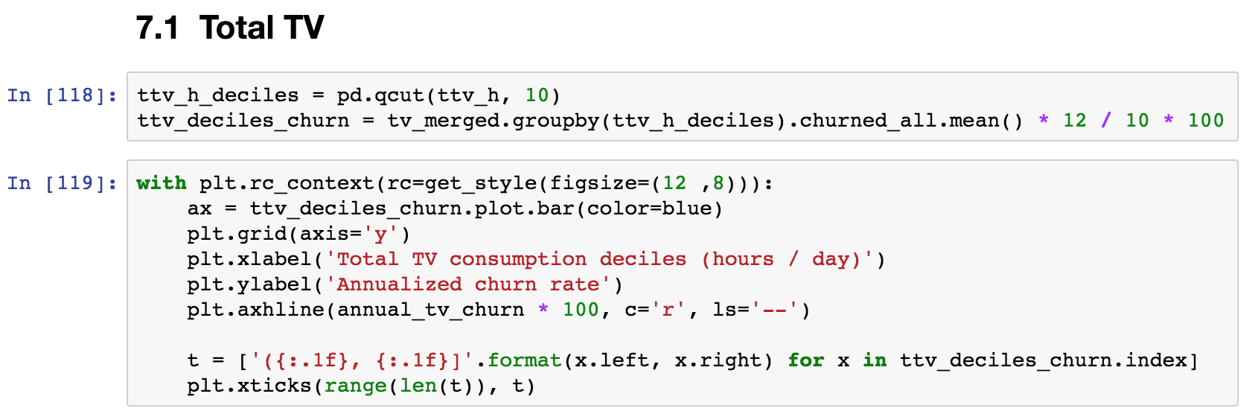
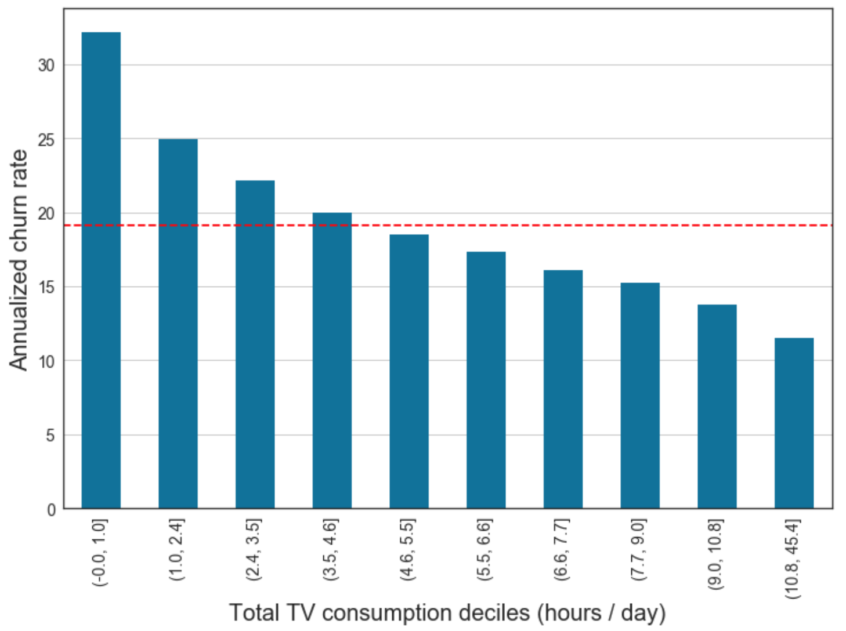
What about this smell?

Slide 4
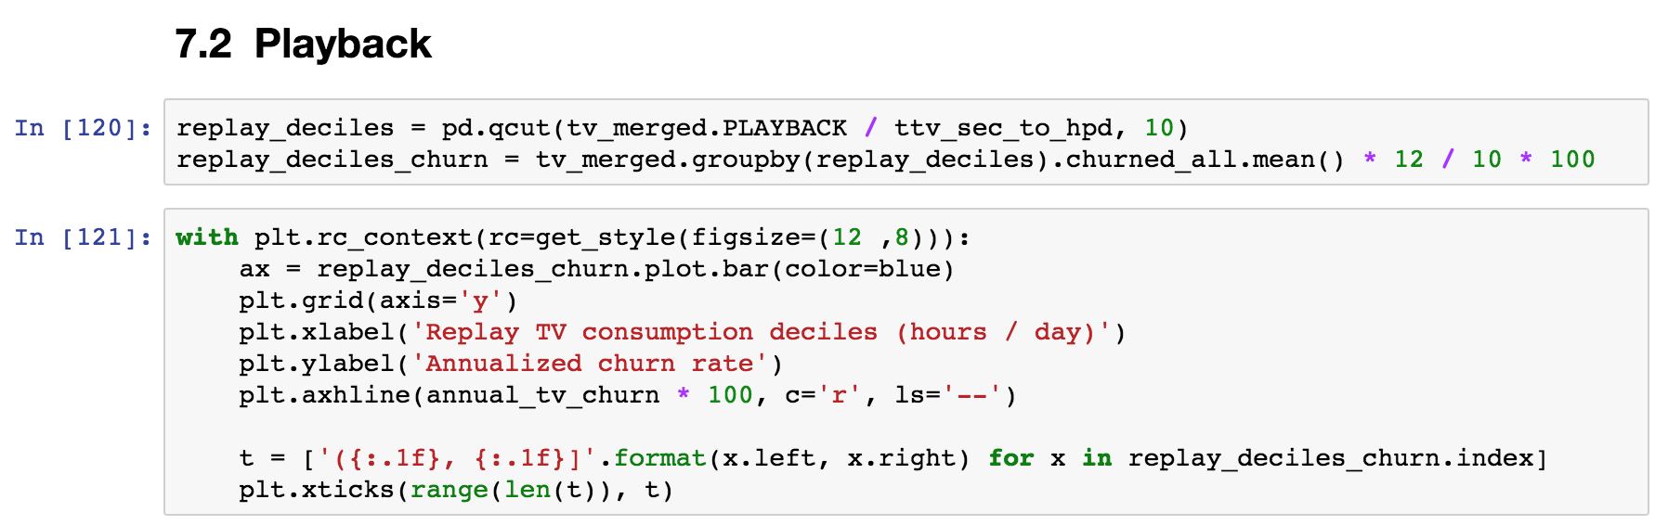
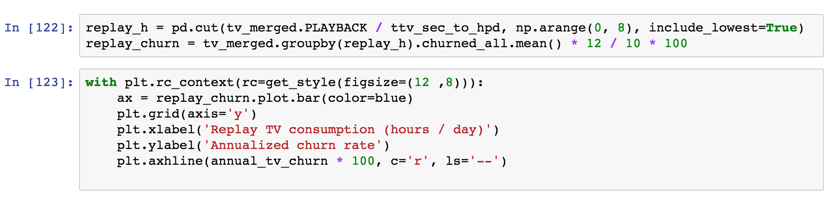
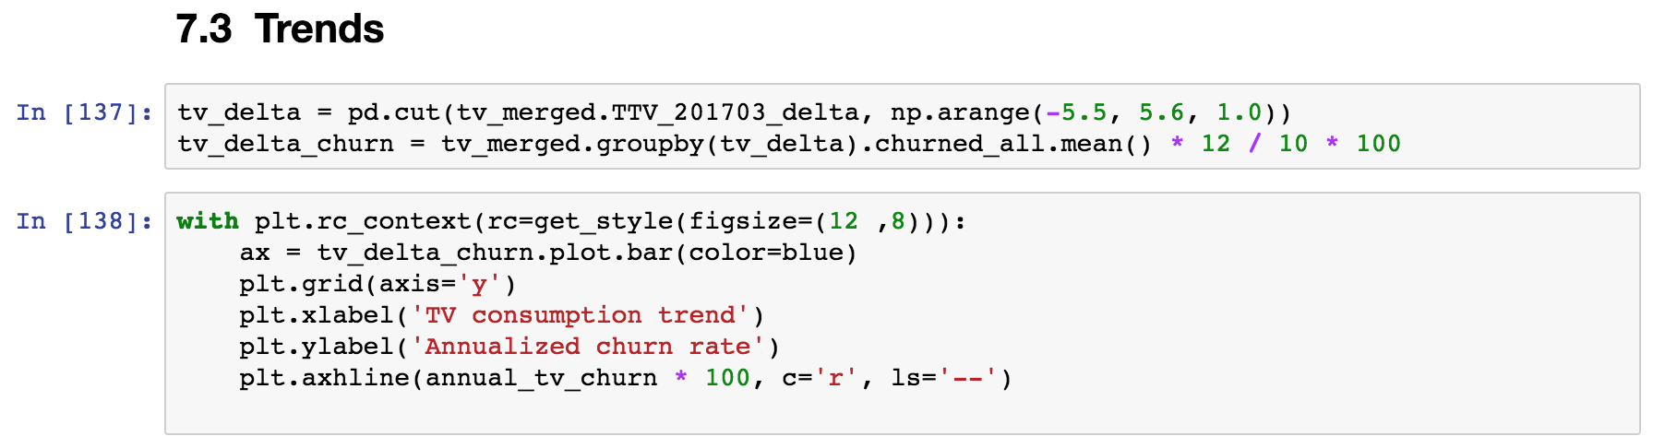
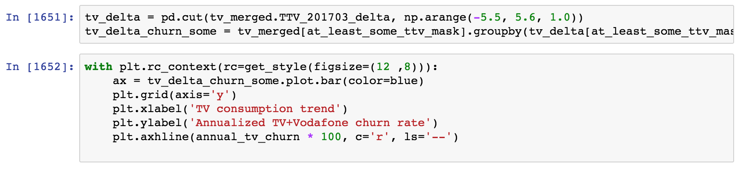
What about this smell?

Slide 5
What is wrong with smelly code?
Redundant, not flexible: an update in one place would need to be duplicated everywhere
Hard to read and test: the code that performs the interesting computation is mixed with the code that does the repetitive boilerplate

Slide 6
Objective
This is a code smell detection crash course for scientific programming
Advanced Python constructs are the way to get rid of the smell!
Notes:
These constructs are not very common in scientific code, and you don’t actually ”need” them. But the same is true of functions!

Slide 7
All the “advanced Python constructs” smells
The smell of generators
The smell of context managers
for ... :
# Transform / filter
for ... :
# Transform / filter
# The interesting part of the code
# Prepare
try:
# The code you care about
finally:
# Clean up
The smell of classes
The smell of decorators
def first_function(x, y, z):
# Something
def second_function(x, y, z):
# Something else
def third_function(x, y, z):
# Something more
def my_function(x, y, z):
# Common boilerplate at beginning
# Function-specific part
# Common boilerplate at end

Slide 8
The smell of context managers
Before executing the code, something needs to happen: open a file, connect to a DB, initialize some hardware
# Initialize context
try:
# The code you care about
finally:
# Clean up context
Once the code has executed, we need to clean up, even if an error occurred: close the file, commit / revert SQL transactions, disconnect from hardware
… becomes …
with my_context_manager():
# The code you care about

Slide 9
The smell of classes
def first_function(x, y, z):
# Something
def second_function(x, y, z):
# Something else
def third_function(x, y, z):
# Something more
The same set of parameters is needed for a set of functions. In code calling this function, one needs extra code to keep these parameters in sync.
… becomes …
def first_function(xyz):
# Something
def second_function(xyz):
# Something else
def third_function(xyz):
# Something more
class Xyz:
def __init__(self, x, y, z):
...

Slide 10
The smell of generators
One or more nested loops, variables over which one iterates requires some extra transformation or filtering
for ... :
# Transform / filter
for ... :
# Transform / filter
# The interesting part of the code
This is the part that actually does some interesting computation. At the moment, it’s hard to test it!
… becomes …
for ... in my_generator():
# The interesting part of the code

Slide 11
The smell of decorators
Boilerplate code at the start and/or end of functions.
Typical cases: logging, deprecation, conditions checks, caching
def my_function(x, y, z):
# Boilerplate at start
# Function-specific part
# Boilerplate at end
This is the part that is specific to what the function actually does
… becomes …
@my_decorator
def my_function(x, y, z):
# Function-specific part

Slide 12
One smell at the time: Context managers

Slide 13
The smell of context managers
Before executing the code, something needs to happen: open a file, connect to a DB, initialize some hardware
# Initialize context
try:
# The code you care about
finally:
# Clean up context
Once the code has executed, we need to clean up, even if an error occurred: close the file, commit / revert SQL transactions, disconnect from hardware
… becomes …
with my_context_manager():
# The code you care about

Slide 14


Electron Microscopes
Computer-colored micrograph of the scales of a tortoiseshell butterfly wing created using a scanning electron microscope. [1]
This scanning electron microscope (SEM) image shows a soma with dendrites (and their spines) radiating from it. [2]
JEOL JEM 2100 Plus, available for booking at EPFL
[1] https://www.britannica.com/technology/scanning-electron-microscope
[2] Thomas Deerinck and Mark Ellisman, 2009

Slide 15
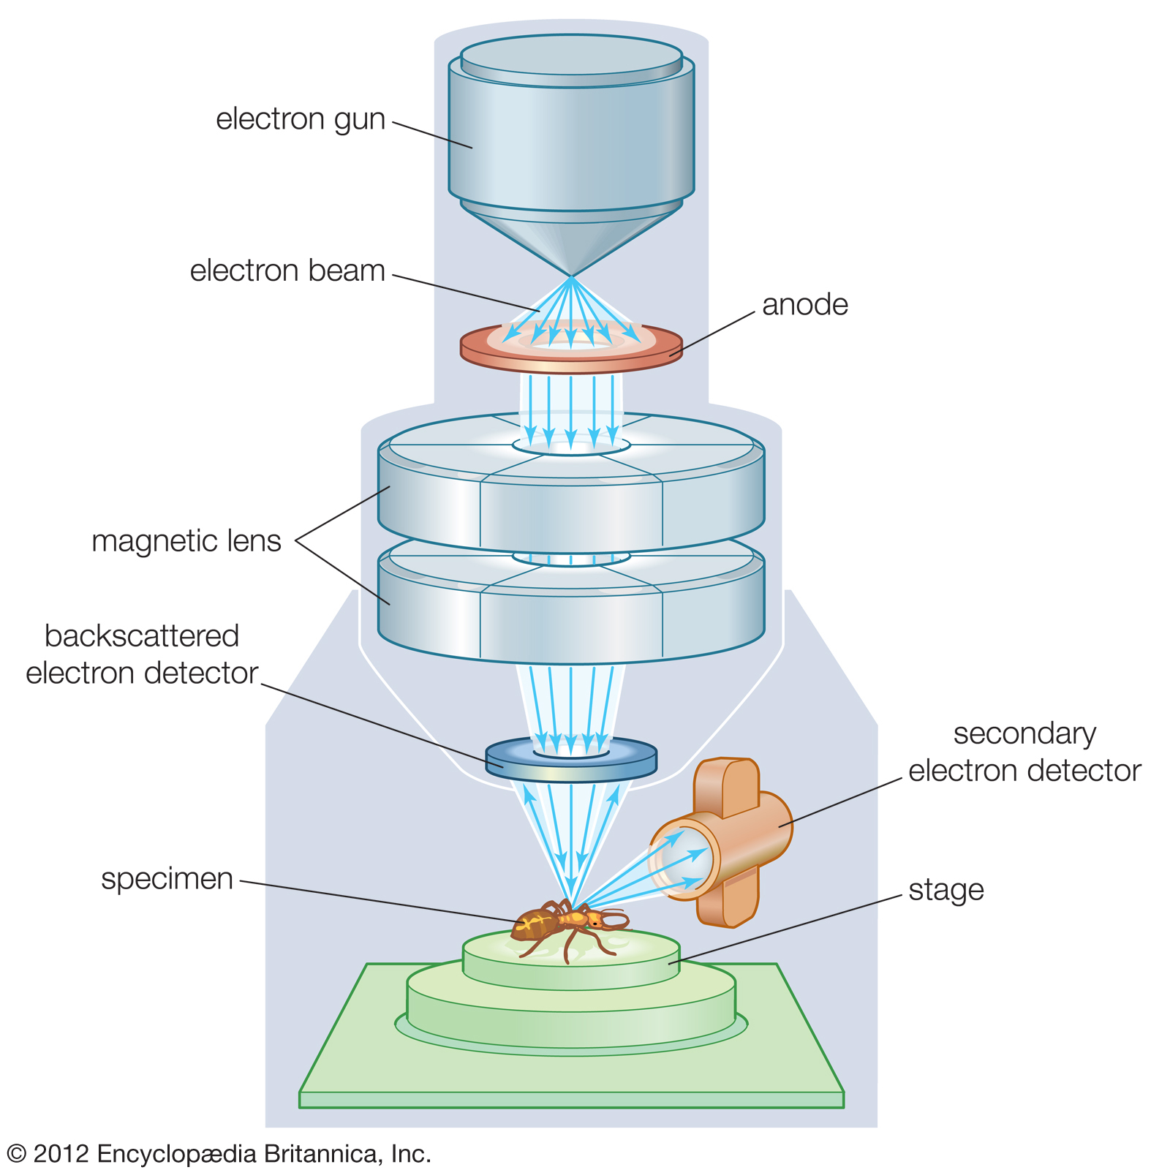
Electron Microscopes
Electron microscopes use a beam of electrons instead of light.
For our purposes, here’s how the microscope works:
Before starting, we need to insert our sample in the microscope through a robotic arm
Then we activate a vacuum pump so that the electrons do not bounce off the air
We let the microscope scan the sample
Finally, we need to switch off the vacuum pump and remove the sample so that other people can use it next

Slide 16
Go to “context managers” notebooks

Slide 17
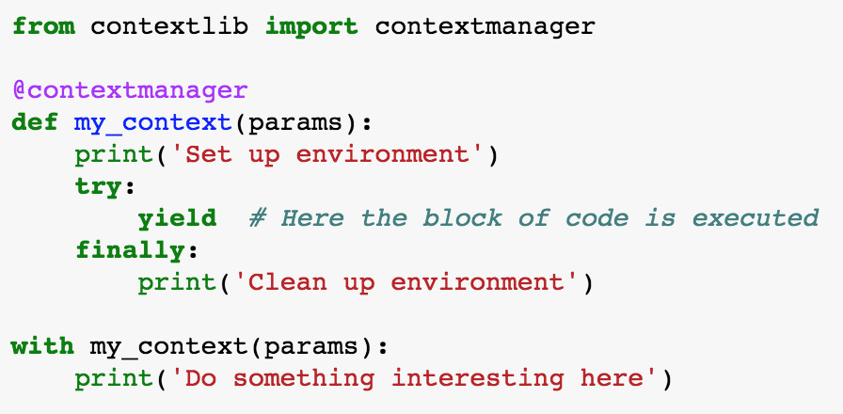
Recap: Context managers
Context managers eliminate the smell of repeatedly setting up and cleaning up an environment in which code needs to run

Slide 18
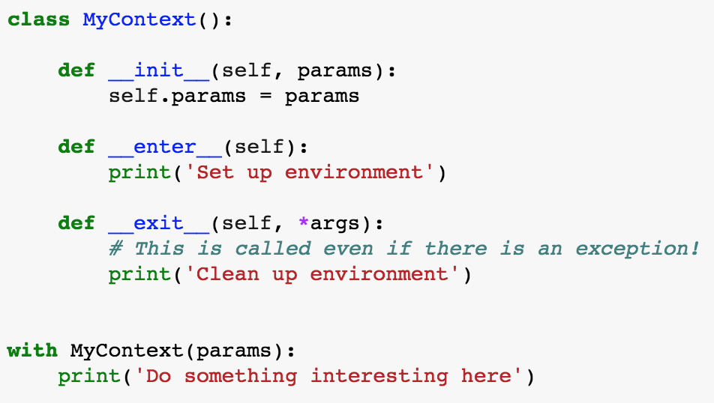
FYI: most general way of defining context manger
@contextmanager is a shortcut for writing a class with magic methods __enter__ and __exit__:

Slide 19
One smell at the time: classes (an introduction)

Slide 20
The smell of classes
def first_function(x, y, z):
# Something
def second_function(x, y, z):
# Something else
def third_function(x, y, z):
# Something more
The same set of parameters is needed for a set of functions. In code calling this function, one needs extra code to keep these parameters in sync.
… becomes …
def first_function(xyz):
# Something
def second_function(xyz):
# Something else
def third_function(xyz):
# Something more
class Xyz:
def __init__(self, x, y, z):
...

Slide 21
Go to “classes” notebooks

Slide 22
Recap: Classes
Classes are used to get rid of set of parameters that belong together and are passed over and over to a set of functions
Classes are templates for bundles of data and “methods”, i.e. functions that have access to the data stored in an instance
A ”class method” is used to build an instance in some alternative way, e.g. using data from a file

Slide 23
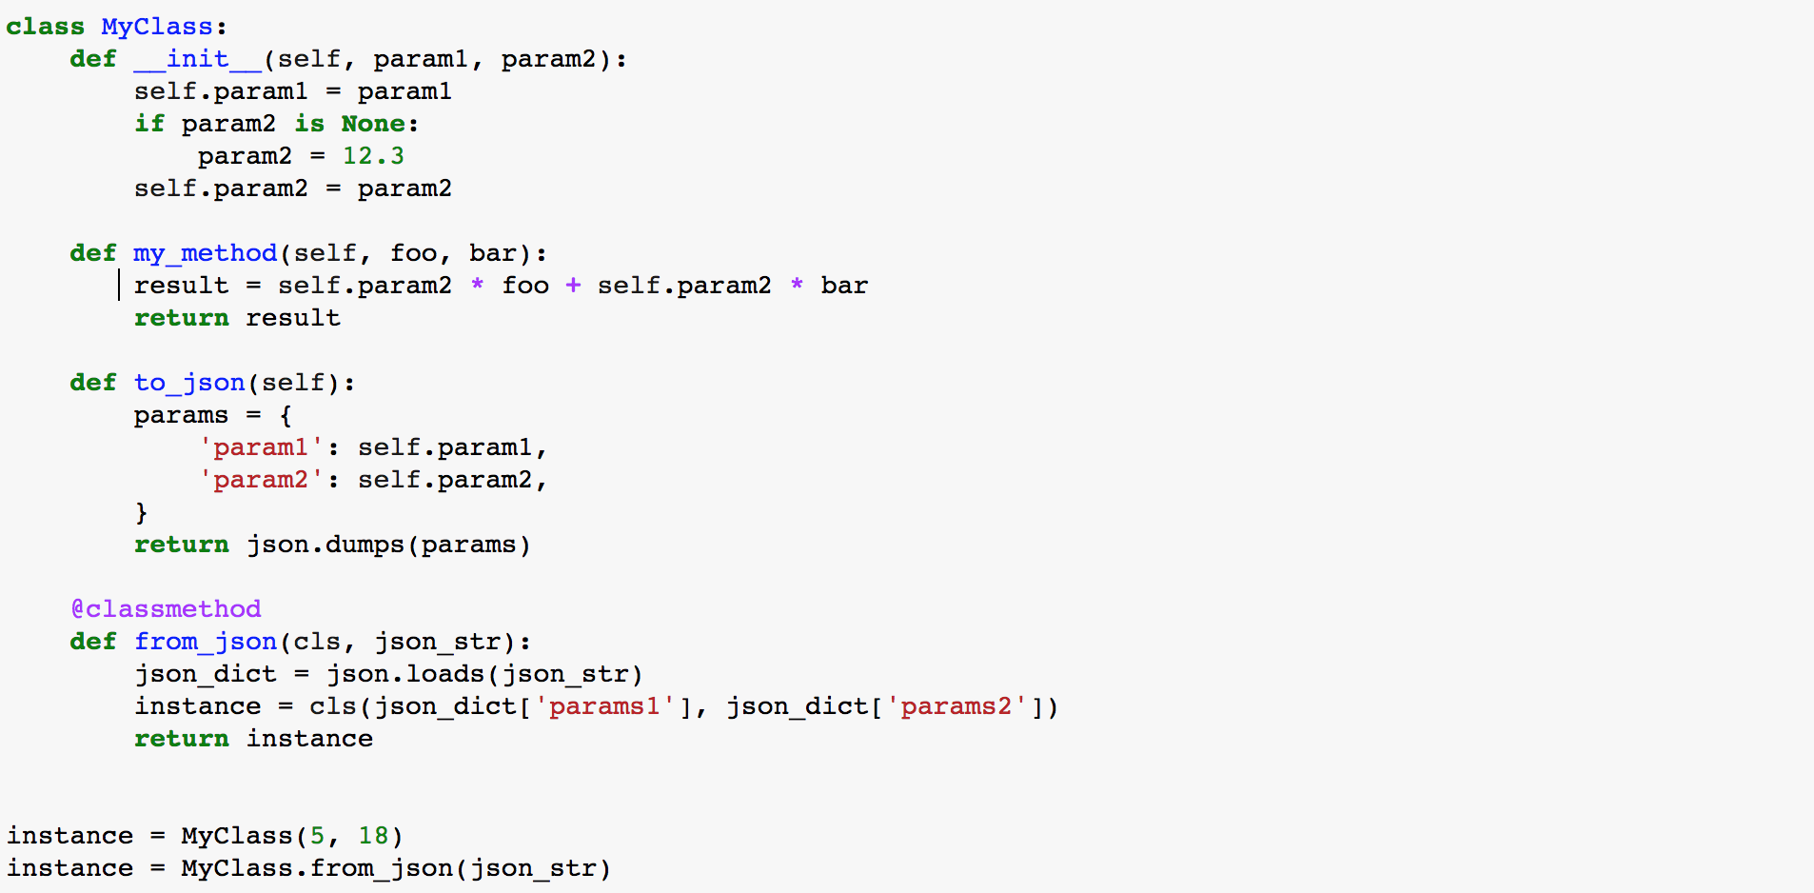
Recap: Class structure
The constructor is used to first populate an instance, called by convention “self”
Classes can define “methods”, i.e. functions that have access to the data stored in an instance
A ”class method” can be used to build an instance in some alternative way, e.g. using data from a file
Here is how you create instances from the constructor or a class method

Slide 24
What belongs to a class?
YES
Data that always belongs together: better create several simple classes than one class that contains everything
Methods to load/save data, create data bundle in different ways (factory methods)
Methods to update the bundled data
NO
Methods to visualize data: follow the Model-View pattern. You will want to visualize the data in many different ways, better have separate utility visualization functions that take one of the instances as input and visualize them.
Similarly, anything for which you can imagine to write 5 different variants depending on your mood
Notes:
Data that belongs together, example of things that go in two different classes: parameters of an experiment and results of the experiment

Slide 25
Another smell of classes
for data in list_of_data:
if data['type'] == 'TYPE1':
type1_foo(data)
type1_bar(data)
elif data['type'] == 'TYPE2':
type2_foo(data)
type2_bar(data)
Several “specializations” of conceptually similar functions
… becomes …
Classes may have methods with the same interface, the class type determines the “specialization”.
One can even define a hierarchy of classes where some methods are re-used!
for instance in instances:
instance.foo(data)
instance.bar(data)

Slide 26
Another smell of classes – simple example
for data in geometric_objects:
if data['type'] == ‘SQUARE':
area = area_square(data)
elif data['type'] == ‘CIRCLE':
area = area_circle(data)
Several “specializations” of conceptually similar functions
… becomes …
Classes may have methods with the same interface, the class type determines the “specialization”.
One can even define a hierarchy of classes where some methods are re-used!
for instance in geometric_objects:
area = instance.area()

Slide 27
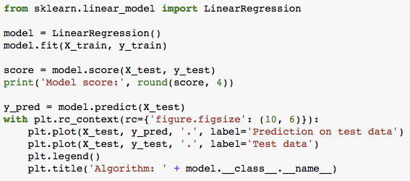
Real example: sklearn
Model score: 0.0066

Slide 28
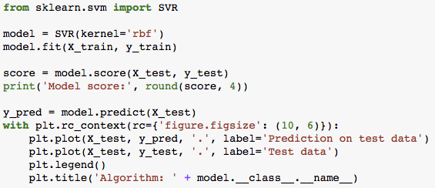
Real example: sklearn
Model score: 0.6144

Slide 29
Keep your nose ready!
The smell of generators
The smell of context managers
for ... :
# Transform / filter
for ... :
# Transform / filter
# The interesting part of the code
# Prepare
try:
# The code you care about
finally:
# Clean up
The smell of classes
The smell of decorators
def first_function(x, y, z):
# Something
def second_function(x, y, z):
# Something else
def third_function(x, y, z):
# Something more
def my_function(x, y, z):
# Common boilerplate at beginning
# Function-specific part
# Common boilerplate at end
g

Slide 30
Where to go from here…
realpython.com

Slide 31
Thank you!

Slide 33
One smell at the time: generators first

Slide 34
The smell of generators
One or more nested loops, variables over which one iterates requires some extra transformation or filtering
for ... :
# Transform / filter
for ... :
# Transform / filter
# The interesting part of the code
This is the part that actually does some interesting computation. At the moment, it’s hard to test it!
… becomes …
for ... in my_generator():
# The interesting part of the code

Slide 35
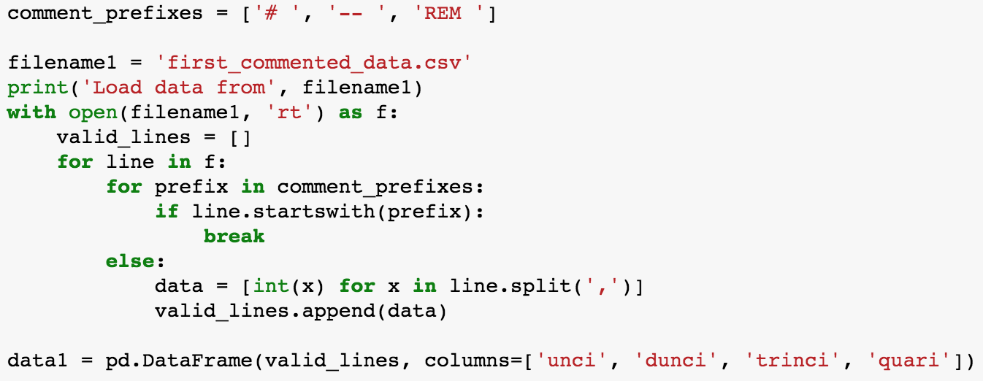
Example
Notes:
Explain context…
Needed to do this for different years, with different computations
Testing this thing will require creating fake, messy files <- this is a complicated point to make, with a generator it requires mocking it…

Slide 36

Ideally…
This is actually what we’d like to write:
Extract each for-loop step in a reusable element and give it a nice name
Do all of this without actually loading all the data in memory for the intermediate steps!
Let’s get there step by step…

Slide 37
Go to “generators” notebooks

Slide 38
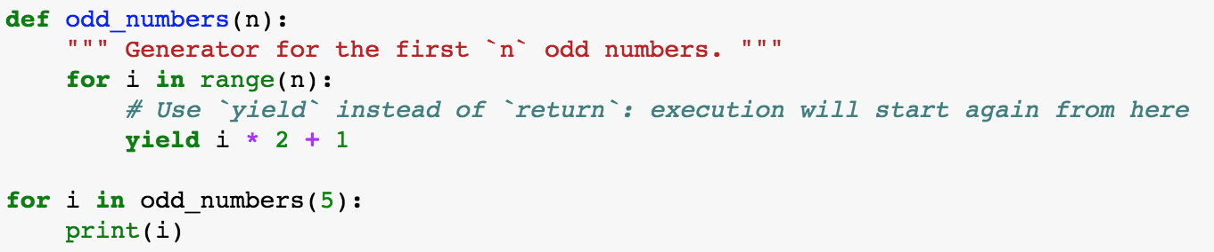
Recap: Generators
Generators are used to get rid of repetitive loops, often nested ”for” loops followed by filtering of the data
Generators return one item at the time, the list of items does not need to be in memory
A generator is defined as a function containing the keyword ”yield”:

